Slide 1
MATHEMATICAL FOUNDATION FOR COMPUTER SCIENCE
Prepared by: Er. Ankit Kharel
Nepal college of information technology

Slide 2
Predicate logic
2.Nested Quantifiers
3.Translation From English

Slide 3
1. NESTED QUANTIFIERS:
1. Consider the following :
“The sum of any two positive real number is positive”
This assertion can be restated as:
“for ever x and for every y , If x>0 and y>0, then x+y>0”
Let,
p(x, y) : “(x>0)^(y>0)→(x+y)>0
The given statement says that the sum of any two positive real number is positive, so we need two Universal quantifiers.
The Quantification is:
∀_{x} ∀_{y} [p(x , y)]

Slide 4
1. NESTED QUANTIFIERS:
3. Consider the following :
“Some student in your class has taken some computer training course”
Restating above statement as:
“For some student x ,there exist a computer training course y such that x has taken y”
let, Q(x, y) : “Student x has taken training y”
The Quantification is:
∃_{x} ∃_{y} [Q(x , y)]

Slide 5
1. NESTED QUANTIFIERS:
4. Consider the following :
“If a person is female and is a parent , then this person is someone’s mother”
Restating above statement as:
“For every person x, if x is a female and person x is a parent , then there exist a person y such that person x is the mother of y.
let, F(x) : “x is female”
P(x) : “ x is parent”
M(x, y) : “x is the mother of y”
The Quantification is:
= ∀_{x}[(F(x)^P(x))→ ∃_{y}M( x, y)]
=∀_{x} ∃_{y} [(F(x)^P(x))→ M( x, y)]

Slide 6
1. NESTED QUANTIFIERS:
5. Consider the following :
“There is a man that has taken a flight on every airline in the world”
Restating above statement as:
“There is a man x, for all airlines a ,there exist a flight f such that x has taken flight f”
let, P(x, f) : “x has taken flight f”
Q(f, a) : “ f is a flight on airline a”
The Quantification is:
=∃_{x} ∀_{a} ∃_{f}[(P(x, f) ^ Q( f, a)]

Slide 7
1. NESTED QUANTIFIERS:
Let,
L(x, y): “x loves y”
“Everyone Loves Somebody”
=For every person x, there exist person y such that x loves y
=∀_{x}∃_{y}L(x, y)
“Someone Loves Somebody”
=There exist some person x and some person y such that x loves y
=∃_{x}∃_{y}L(x, y)
“Someone is loved by everyone”
=There exist some person y for all x such that x loves y.
=∃_{y}∀_{x}L(x, y)
“Everybody Loves Everybody”
= ∀_{x} ∀_{y}L(x, y)

Slide 8
Q. Let Q(x, y) denote “x + y = 0.”
What are the truth values of the quantifications
∃_{y}∀_{x}Q(x, y) and b)∀_{x}∃_{y}Q(x, y), where the domain for all variables consists of all real numbers?
Solution:
a) The quantification ∃_{y}∀_{x}Q(x, y) denotes the proposition “There is a real number y such that for every real number x, Q(x, y).” No matter what value of y is chosen, there is only one value of x for which x + y = 0. Because there is no real number y such that x + y = 0 for all real numbers x, the statement ∃_{y}∀_{x}Q(x, y) is false.
b)The quantification ∀_{x}∃_{y}Q(x, y) denotes the proposition “For every real number x there is a real number y such that Q(x, y).” Given a real number x, there is a real number y such that x + y = 0; namely, y = −x. Hence, the statement ∀_{x}∃_{y}Q(x, y) is true.
Q. Let P (x, y) be the statement “x + y = y + x.”
What are the truth values of the quantifications a)∀_{x}∀_{y}P (x, y) and b)∀_{y}∀_{x}P (x, y) where the domain for all variables consists of all real numbers?
Solution:
a)The quantification ∀_{x}∀_{y}P (x, y) denotes the proposition “For all real numbers x, for all real numbers y,
x + y = y + x.” Because P (x, y) is true for all real numbers x and y the proposition ∀_{x}∀_{y}P (x, y) is true.
b)The quantification ∀_{y}∀_{x}P (x, y) says “For all real numbers y, for all real numbers x, x + y = y + x.”
Because P (x, y) is true for all real numbers x and y the proposition ∀_{y}∀_{x}P (x, y) is true.

Slide 9
Q. Let Q(x, y) denote “x + y = xy.”
What are the truth values of the quantifications
∃_{x}∃_{y}Q(x, y) and b)∃_{y}∃_{x}Q(x, y),domain for all variables consists of all positive real numbers?
Solution:
The quantification ∃_{x}∃_{y}Q(x, y) denotes the proposition “There is exist a number x such that for some number y, Q(x, y).” Q(x, y) is true for x=(0,2) and y= (0, 2). Hence, ∃_{x}∃_{y}Q(x, y) is TRUE
b) The quantification ∃_{y}∃_{x}Q(x, y) denotes the proposition “There is exist a number y such that for some number x, Q(x, y).” Q(x, y) is true for y=(0,2) and x= (0, 2). Hence, ∃_{y}∃_{x}Q(x, y) is TRUE
∃_{y}∀_{x}Q(x, y) !=∀_{x}∃_{y}Q(x, y)
∀_{x}∀_{y}P (x, y) =∀_{y}∀_{x}P (x, y)
∃_{x}∃_{y}P(x, y) =∃_{y}∃_{x}P(x, y)

Slide 10
2. NEGATING NESTED QUANTIFIERS:
Statements involving nested quantifiers can be negated by successively applying the De-Morgan’s rules for negating statements involving a single quantifier.
Express the negation of the statement ∀_{x}∃_{y}(xy = 1).
=¬[∀_{x}∃_{y}(xy = 1)]
=∃_{x}¬[∃y(xy = 1)]
=∃_{x}∀_{y}¬(xy = 1)
= ∃_{x}∀_{y}(xy!=1)
b) ∃_{x}∃_{y} P(x, y) ∧ ∀_{x}∀_{y} Q(x, y)
= ¬[∃_{x}∃_{y} P(x, y) ∧ ∀_{x}∀_{y} Q(x, y)]
=¬[∃_{x}∃_{y} P(x, y)] ∨ ¬[∀_{x}∀_{y} Q(x, y)]
= ∀_{x}¬∃_{y} P(x, y) ∨ ∃_{x}¬∀_{y} Q(x, y)
= ∀_{x}∀_{y} ¬P(x, y) ∨ ∃_{x}∃_{y} ¬ Q(x, y)

Slide 11
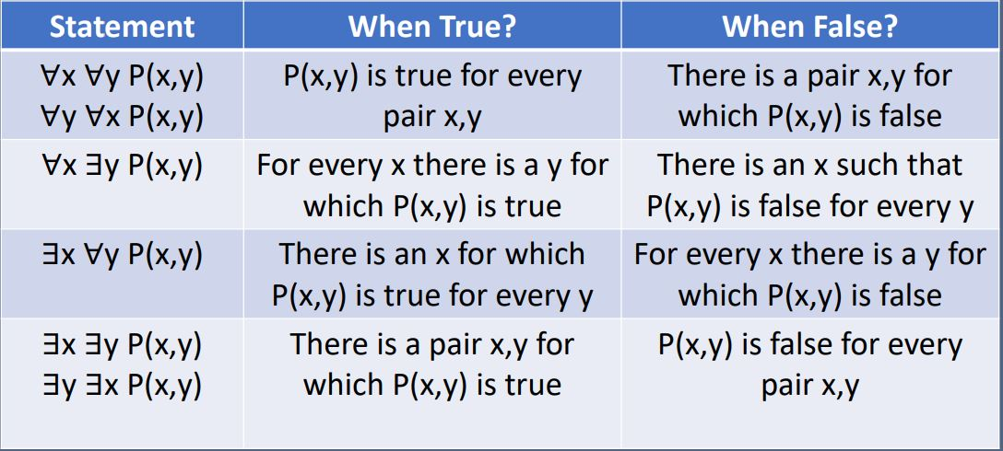
∀x ∃y P(x, y)
=¬[∀x ∃y P(x, y)]
= ∃_{x}¬∃y P(x, y)
= ∃_{x} ∀_{y} ¬ P(x, y)
∃_{x} ∀_{y} P(x, y)
=¬[∃_{x} ∀_{y} P(x, y)]
= ∀_{x}¬∀_{y} P(x, y)
= ∀_{x} ∃_{y} ¬ P(x, y)

Slide 12
3. Translating from Nested Quantifiers into English:
Q. Translate the statement:
∀_{x}[C(x) ∨ ∃_{y}(C(y) ∧ F (x, y))] into English, where
C(x) is “x has a computer,”
F (x, y) is “x and y are friends,” and the domain for both x and y consists of all students in your school.
Solution:
The statement says that “for every student x in your school, x has a computer or there is a student y such that y has a computer and x and y are friends.”
In other words, “Every student in your school has a computer or has a friend who has a computer”

Slide 13
3. Translating from Nested Quantifiers into English:
Q. Translate the statement:
∀_{x}[S(x) ∨ ∃_{y}(S(y) ∧ F (x, y))] into English, where
S(x) is “x uses snapchat”
F (x, y) is “x and y are friends,” and the domain for both x and y consists of all students in your school.
Solution:
The statement says that “for every student x in your school, x either uses snapchat or there is a student y such that y uses snapchat and y and x are friends.”
In other words, “Every student in your school either uses snapchat or are friends with a student who uses snapchat”

Slide 14
3. Translating from Nested Quantifiers into English:
Q. Translate the statement
∃_{x}∀_{y}∀_{z}((F (x, y) ∧ F (x, z) ∧ (y != z)) → ¬F (y,z))
into English, where F (a, b) means a and b are friends and the domain for x, y, and z consists of all students in your school.
Solution:
We first examine the expression (F (x, y) ∧ F (x, z) ∧ (y = z)) → ¬F (y, z). This expression says that if students x and y are friends, and students x and z are friends, and furthermore, if y and z are not the same student, then y and z are not friends.
It follows that the original statement, which is triply quantified, says that “there is a student x such that for all students y and all students z other than y, if x and y are friends and x and z are friends, then y and z are not friends. In other words,
“There is a student none of whose friends are also friends with each other.”

